Slide 1
Longitudinal Modeling of Cognitive Decline in Older Adults Using GLM, GEE, and GLMM:
An Analysis of the OASIS-2 Cohort BIOS667 Group 6: Yini Lu, Wan-Chen Lin,Rui Peng, Yixin Zhang

Slide 2
Introduction
Speaker: Yini Lu

Slide 3
Background
Alzheimer’s Disease (AD) and Cognitive Decline
Alzheimer’s disease is the most common cause of dementia and represents a major global public health challenge.
As populations age, the burden on healthcare systems and caregivers continues to grow.
Mini-Mental State Examination (MMSE): Assess global cognition
strongly predictive of subsequent cognitive and functional decline
A score below 24 is commonly interpreted as poor cognition and signals risk for functional decline
Education may shape cognitive reserve and influence both baseline cognition and how cognition changes over time.

Slide 4
Research Questions
How are education levels associated with the probability of poor cognition (Binary Outcome), and how does this probability change over time?
How do education levels associate with the MMSE scores (Continuous Outcome)?
Dataset: OASIS longitudinal dataset, which includes repeated MMSE measurements across Nondemented (Control), Demented (AD), and Converted (MCI) participants.

Slide 5
Data Description
Speaker: Yini Lu

Slide 6
Take a glance at our dataset
Get access: Kaggle, OASIS-2 longitudinal cohort
A study designed to track brain aging and Alzheimer’s disease progression
Longitudinal MRI and cognitive assessment study
Each participant completed 1–4 visits
Collected at each visit:
Demographics (Age, Sex, Education, etc.)
MMSE cognitive scores

Slide 7
Descriptive Statistics
Sample Used in This Study
Valid baseline MMSE, and
≥ 1 follow-up visit for longitudinal analysis
Cohort Overview
142 adults, ages 60–96
Education level distribution:
46 Low-Education
30 Medium-Education
66 High-Education

Slide 8
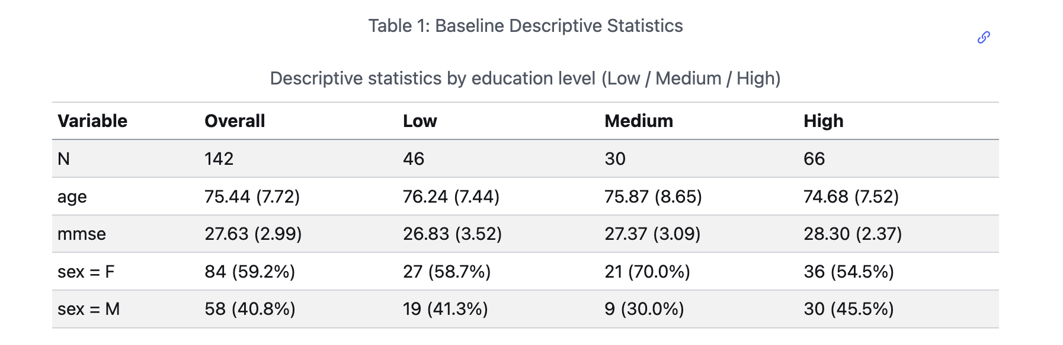

Slide 9
Methods

Slide 10
GLM
Speaker: Rui Peng

Slide 11
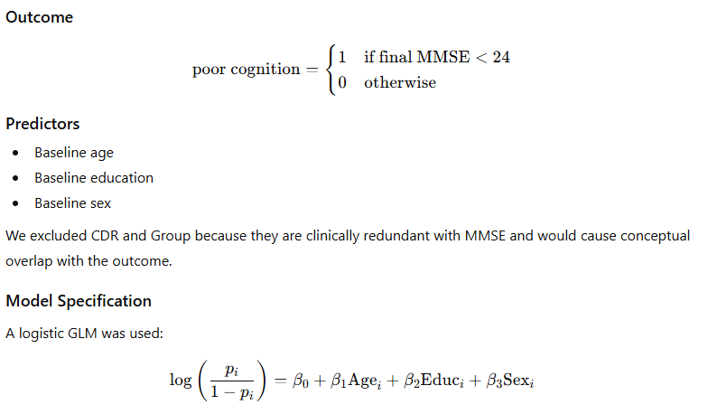
RQ1
Diagnostics
Discrimination: ROC curve, AUC
Classification: accuracy, sensitivity, specificity, PPV, F1
Residual diagnostics: deviance residuals
Influence diagnostics: Cook’s distance
Goodness: Hosmer–Lemeshow goodness-of-fit test

Slide 12
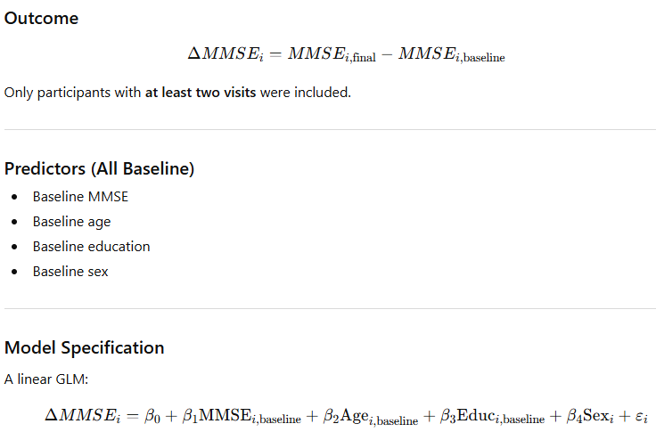
RQ2: How do baseline age, education, and sex predict change in cognition (ΔMMSE) from first to last visit?
Diagnostics
Linearity: residuals vs fitted
Normality: Q–Q plot
Homoscedasticity: scale-location check
Influence: Cook’s distance
Leverage: residuals vs leverage
Multicollinearity: VIF

Slide 13
Results of Q1 - GLM

Slide 14
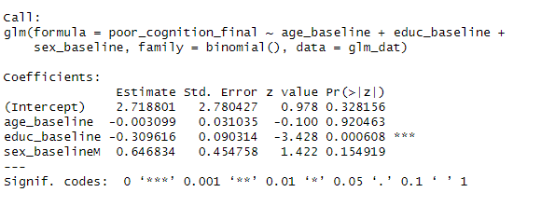
1) summary table of Logistic Model
Education level are the key predictors of poor cognition at the final visit.
Coefficient:For every additional year of education at baseline, the odds of having poor cognition at the final visit decrease by about 26%.

Slide 15
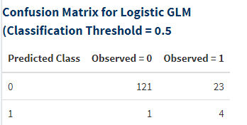
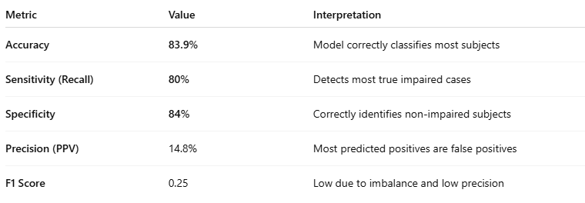
2)Classify table & Model Performance Metrics

Slide 16
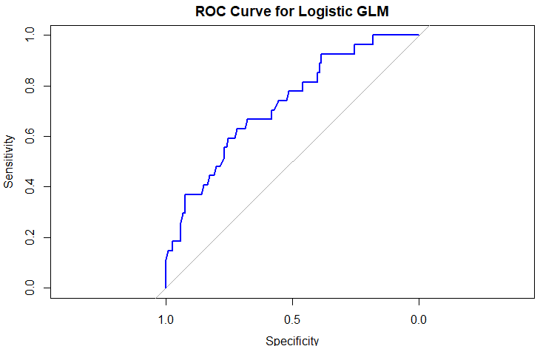
3)ROC & AUC
The ROC curve rises steeply and stays well above the 45° chance line.
AUC = 0.726, indicating good discriminative performance.
The model reliably separates:
Impaired (poor cognition) vs Non-impaired individuals.

Slide 17
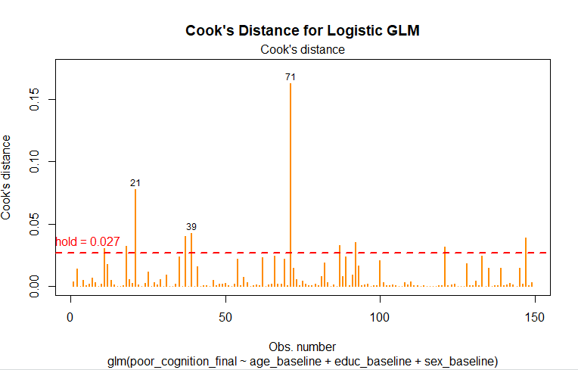
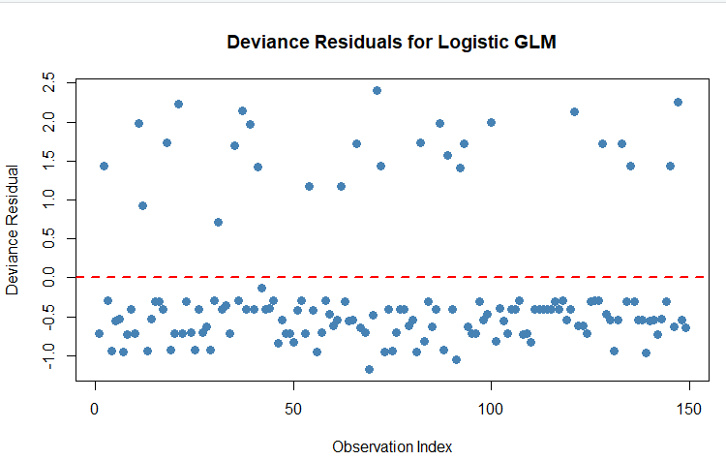
4)Residuals plots & influence plots

Slide 18

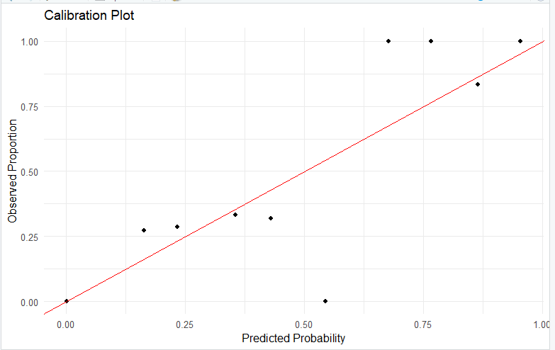
5)Goodness

Slide 19
Results of Q2 - GLM

Slide 20
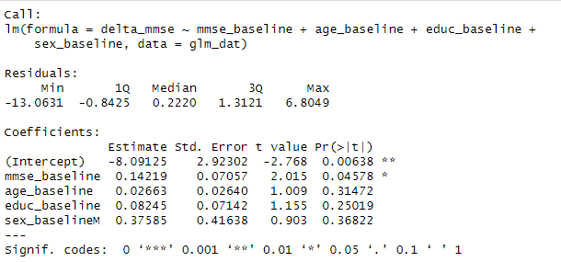
1)summary table of Linear Model

Slide 21

2)Check multicollinearity (VIF)
Variance inflation factors (VIFs) for all predictors were approximately 1 indicating no evidence of multicollinearity among baseline age, education, and sex. Therefore, all predictors can be interpreted without concern for inflated variances or instability in the coefficient estimates

Slide 22
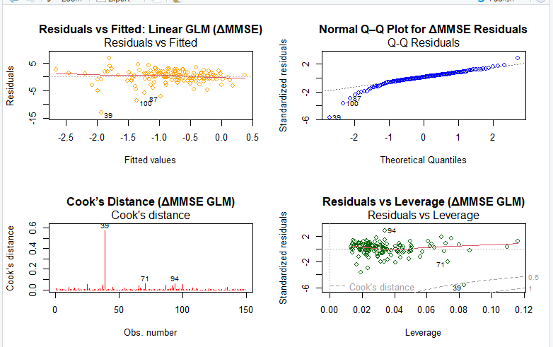

Slide 23
Summary GLM (Q1& Q2)
RQ1 — Logistic GLM: Predicting Poor Cognition
Key Results
Only education significantly predicted poor cognition
Model performance Accuracy: 83.9% Sensitivity: 80% Specificity: 84% Precision: 14.8% (low due to rare events) AUC: 0.726 (moderate discrimination)
Good calibration; no major diagnostics issues
RQ2 — Linear GLM: Predicting ΔMMSE
Key Results
Age, education, and sex were not significant predictors
VIFs ≈ 1 → no multicollinearity
Diagnostics revealed model limitations: Non-normal residuals,Heteroscedasticity Influential outliers
ΔMMSE has very little variability

Slide 24
GEE
Speaker: Yixin Zhang

Slide 25
Model Specification
Logistic GEE (RQ1)
Gaussian GEE (RQ2)
Notes:
Link Function: Logit for binary, Identity for continuous. Interaction (Visit × Educ): Tests if the rate of cognitive change differs by education level.

Slide 26
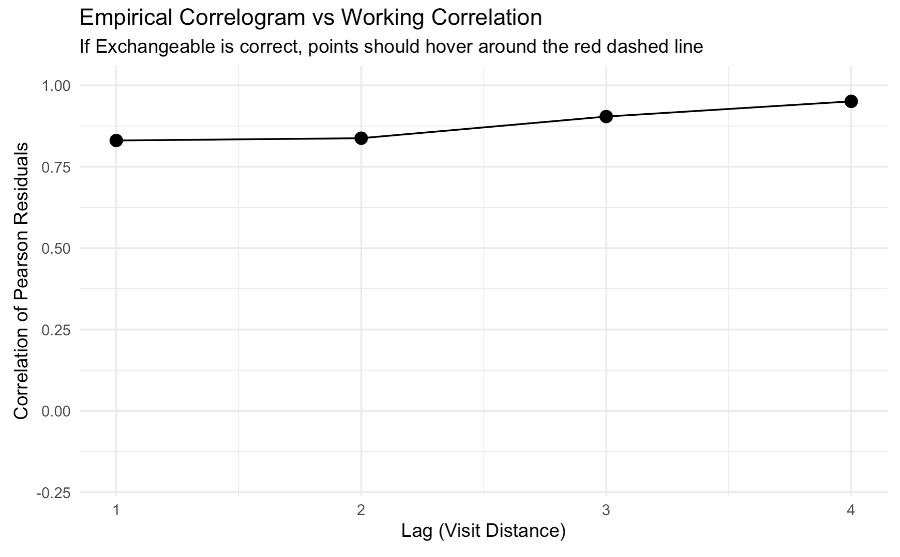
Choosing Correlation Structure
Selection Process
We compared Independence, Exchangeable, and AR-1 working correlation structures.
Decision: Exchangeable
RQ1: Lowest QIC value(294).
RQ2: Supported by the empirical correlogram despite QIC scores.
Rationale: The empirical correlation (right) remained high and stable across visit lags, justifying the exchangeable assumption.

Slide 27
Results - GEE

Slide 28
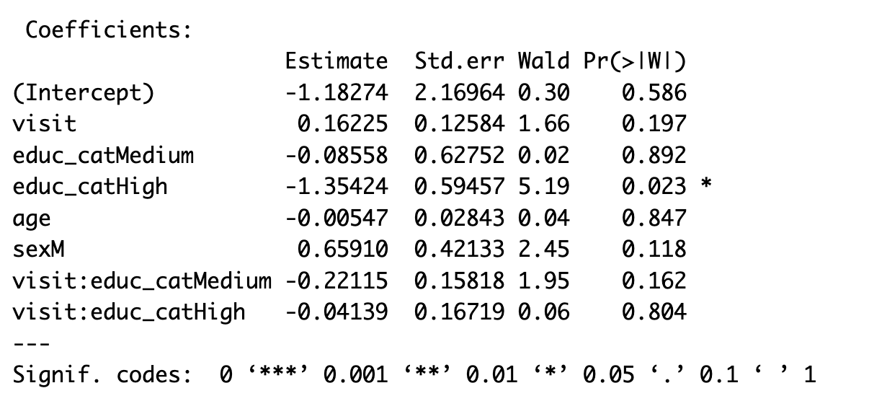
RQ1 Result - Binary Outcome

Slide 29
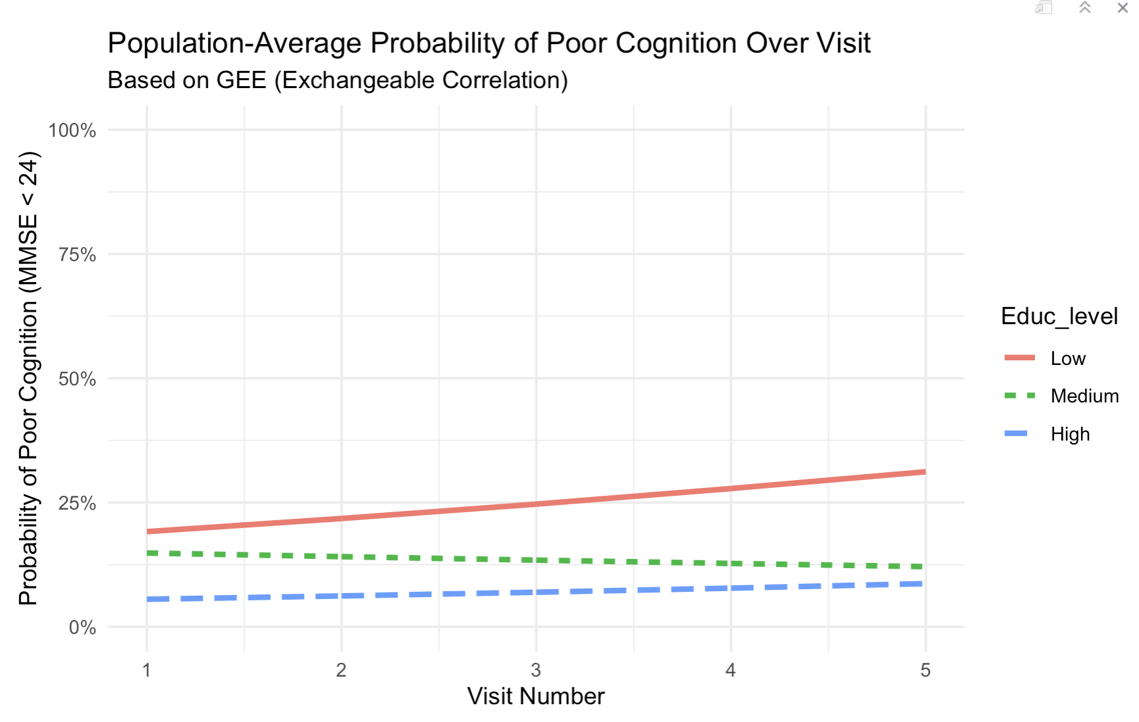
RQ1 Result - Predicted Probability
The plot displays the population-average predicted probability of "poor cognition" across visits.
High Education: Consistently lowest risk.
Low Education: Consistently highest risk.
Interpretation: Improved education provides a stable buffer against falling below clinical impairment thresholds (MMSE < 24).

Slide 30
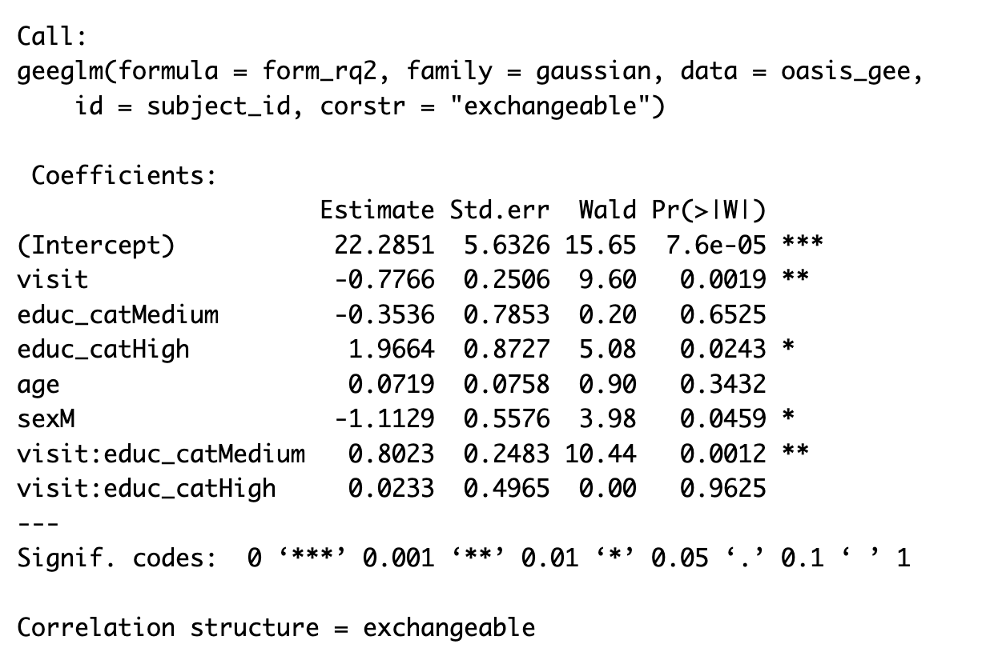
RQ2 Result - Continuous Scores

Slide 31
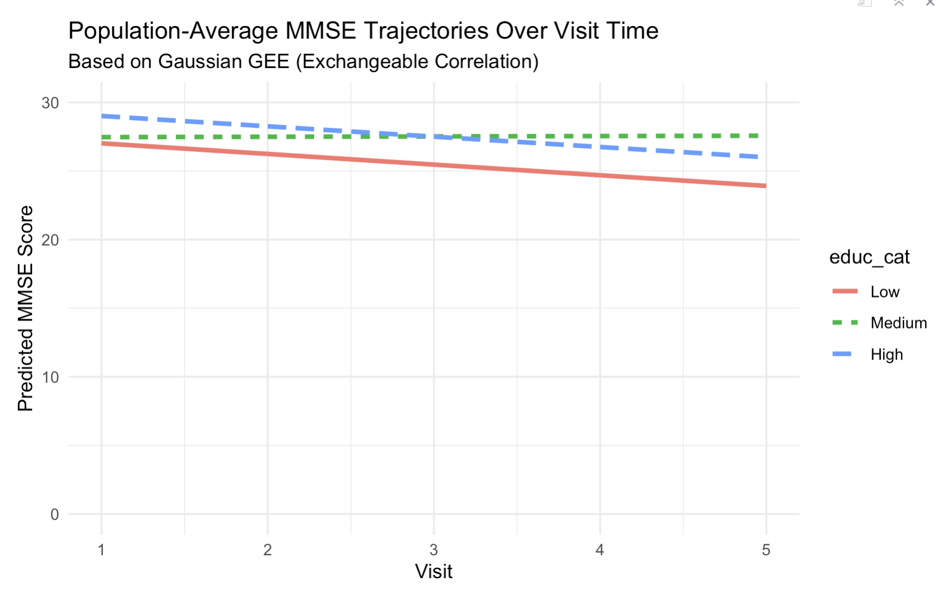
RQ2 Result
The Gaussian GEE model reveals distinct longitudinal profiles:
Low Education: Steepest decline over time.
Medium Education: Slower rate of decline, showing resilience.
High Education: Sustains the highest cognitive status throughout, primarily due to the strong baseline advantage.

Slide 32
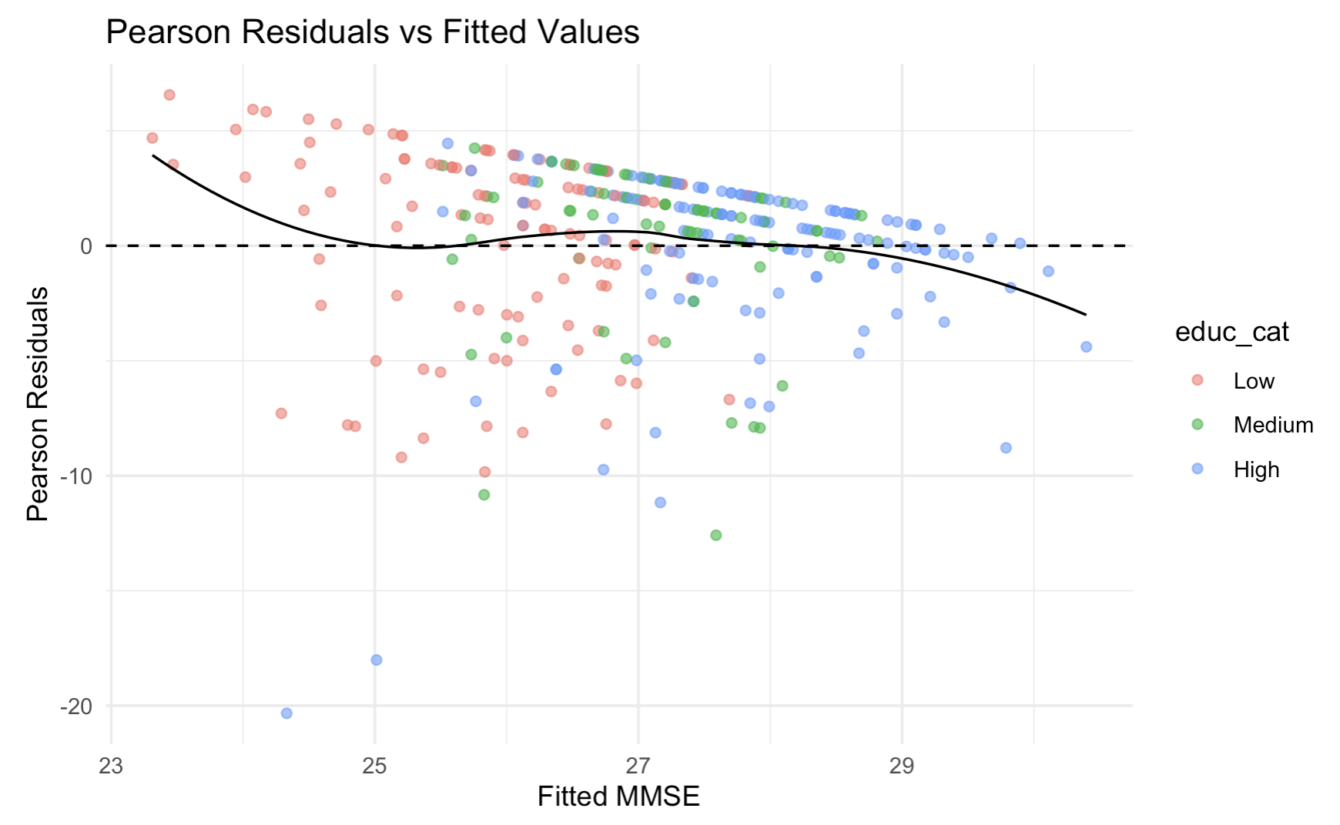
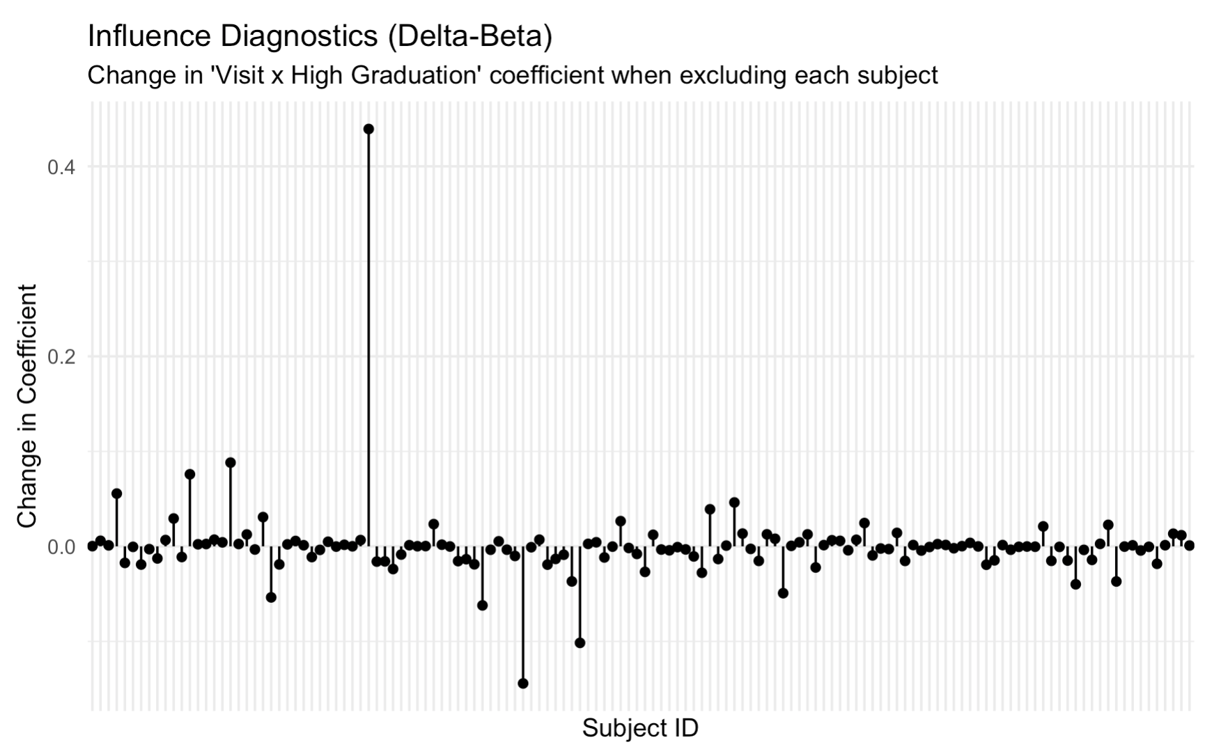
Model Diagnosis

Slide 33
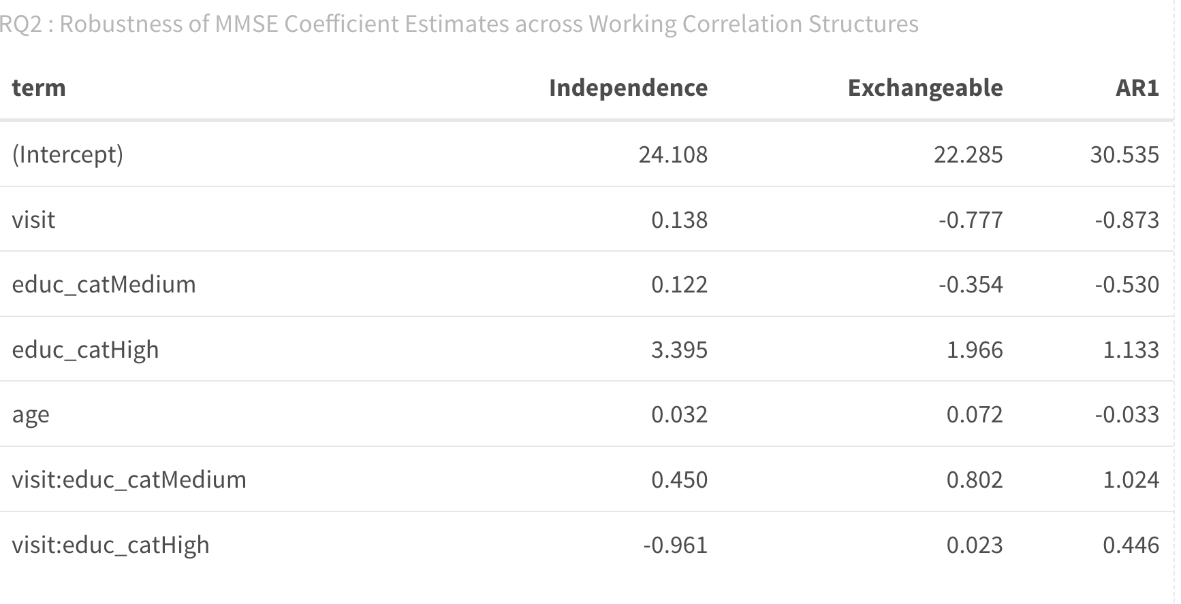
Model Diagnosis - Robustness Check

Slide 34
Conclusion
Key Takeaways:
In both RQ1 and RQ2, higher education emerged as a consistent protective factor.
Lower odds of poor cognition (Binary).
Higher overall MMSE performance (Continuous).
Robust across different correlation structures.

Slide 35
GLMM
Speaker: Wan-Chen Lin

Slide 36
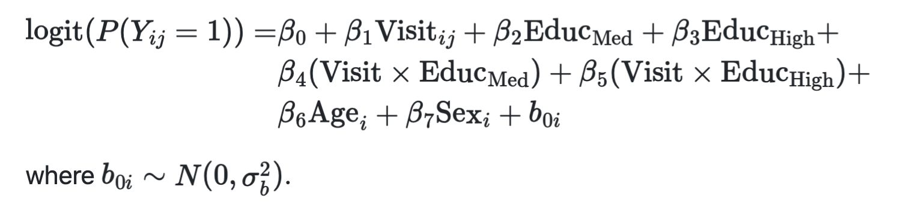
Model Specification
RQ1:
Model Simplification:
Initial models including random slopes resulted in a singular fit (correlation = 1.0). Therefore, a parsimonious random-intercept-only structure was adopted.

Slide 37
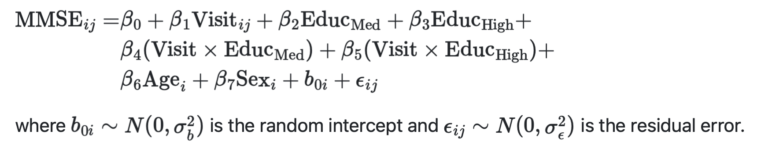
Model Specification
RQ1:
RQ2:

Slide 38
Results - GLMM

Slide 39
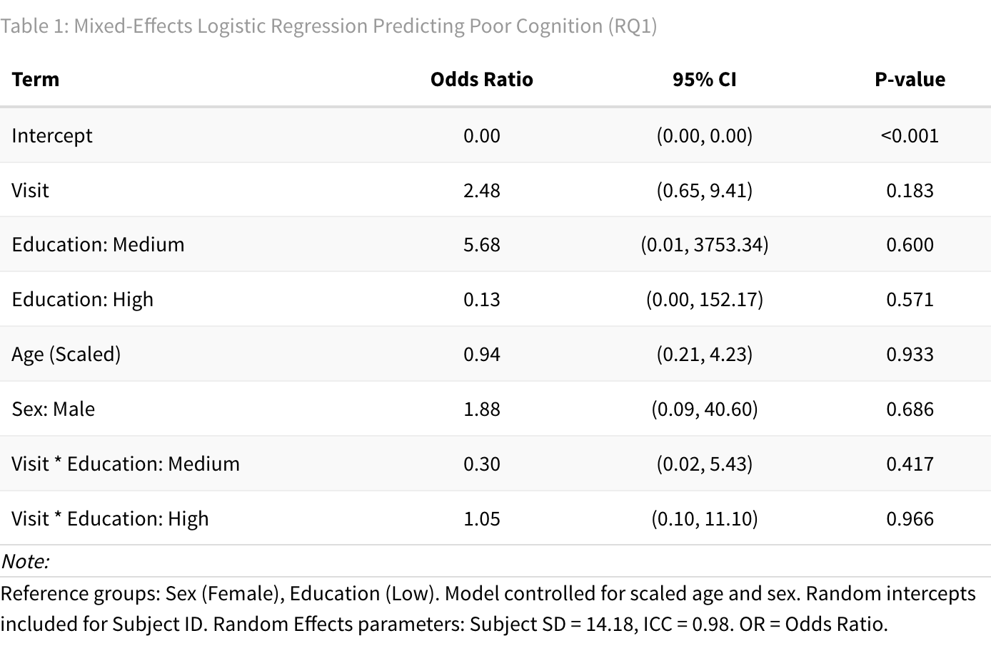
RQ1: Model Summary

Slide 40
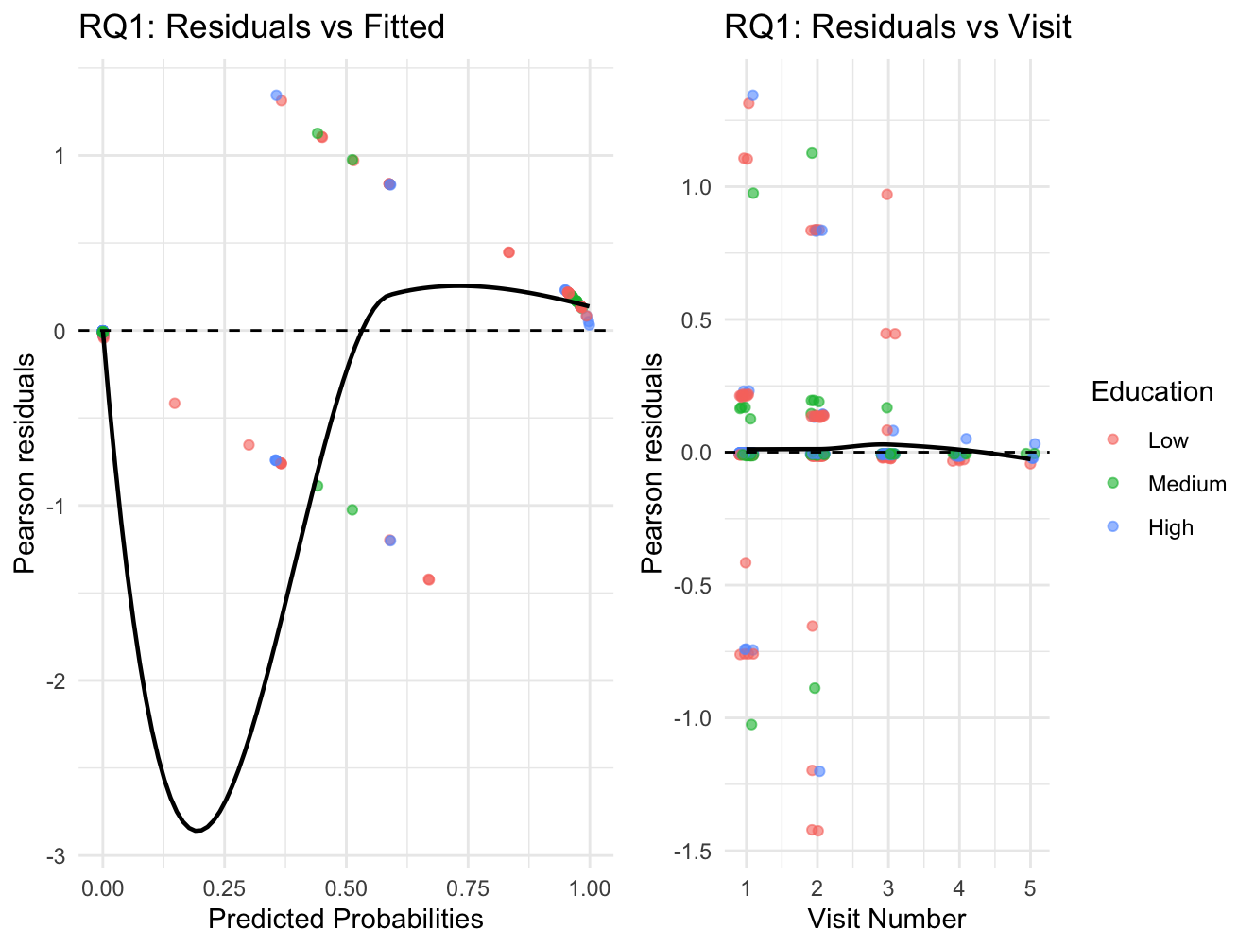
RQ1: Diagnostics

Slide 41
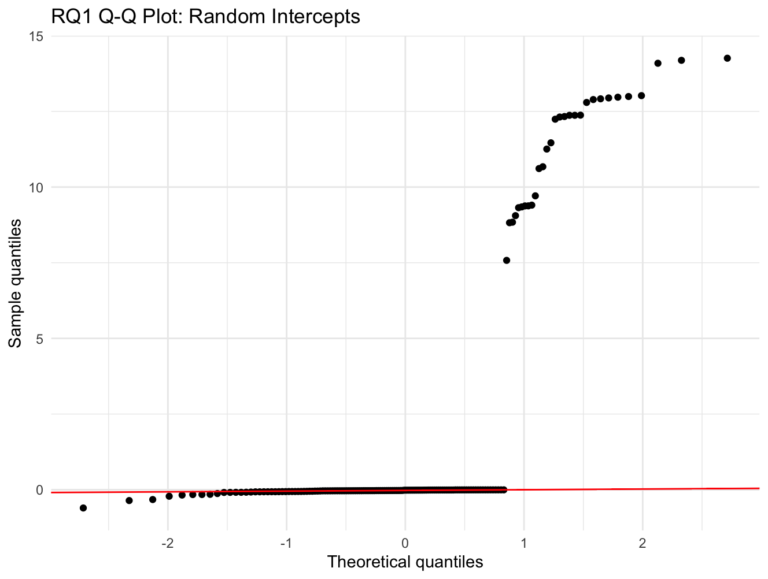
RQ1: Diagnostics

Slide 42
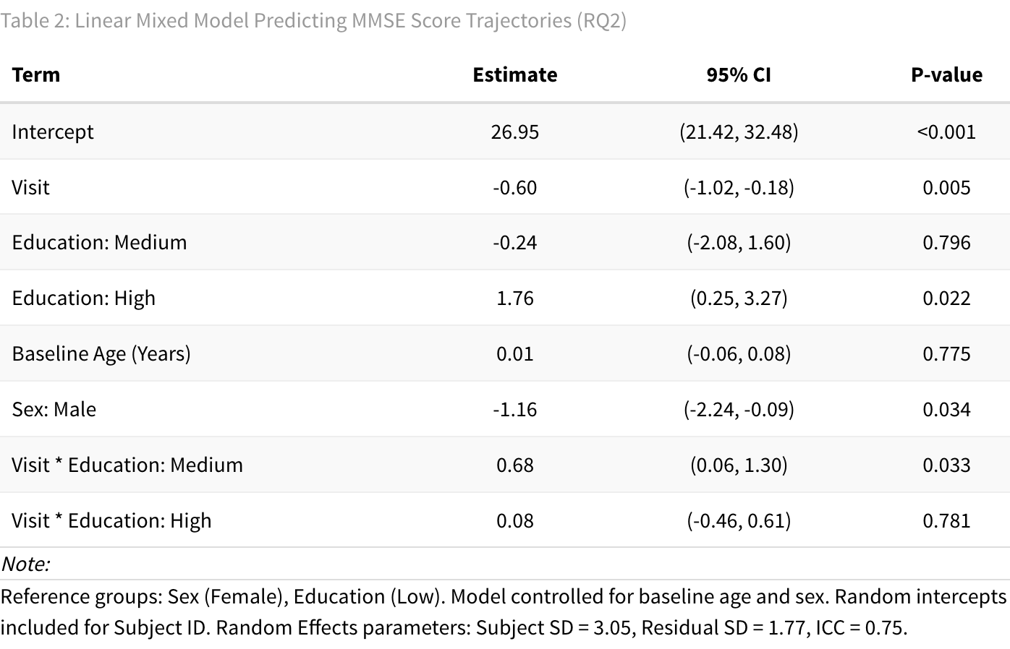
RQ2: Model Summary

Slide 43
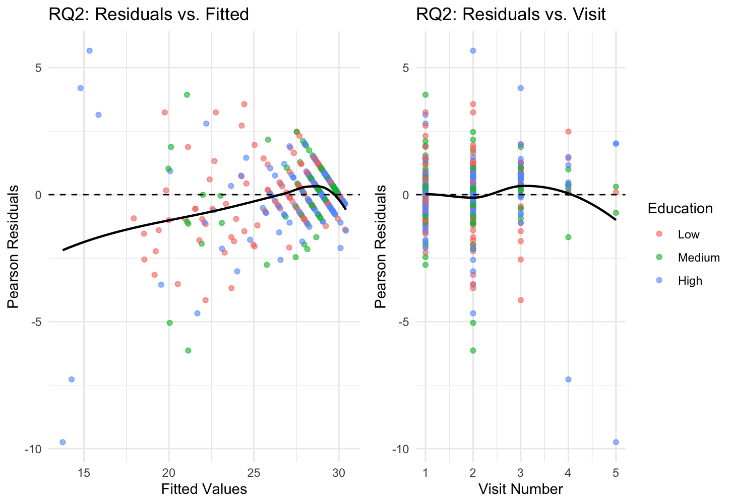
RQ2: Diagnostics

Slide 44
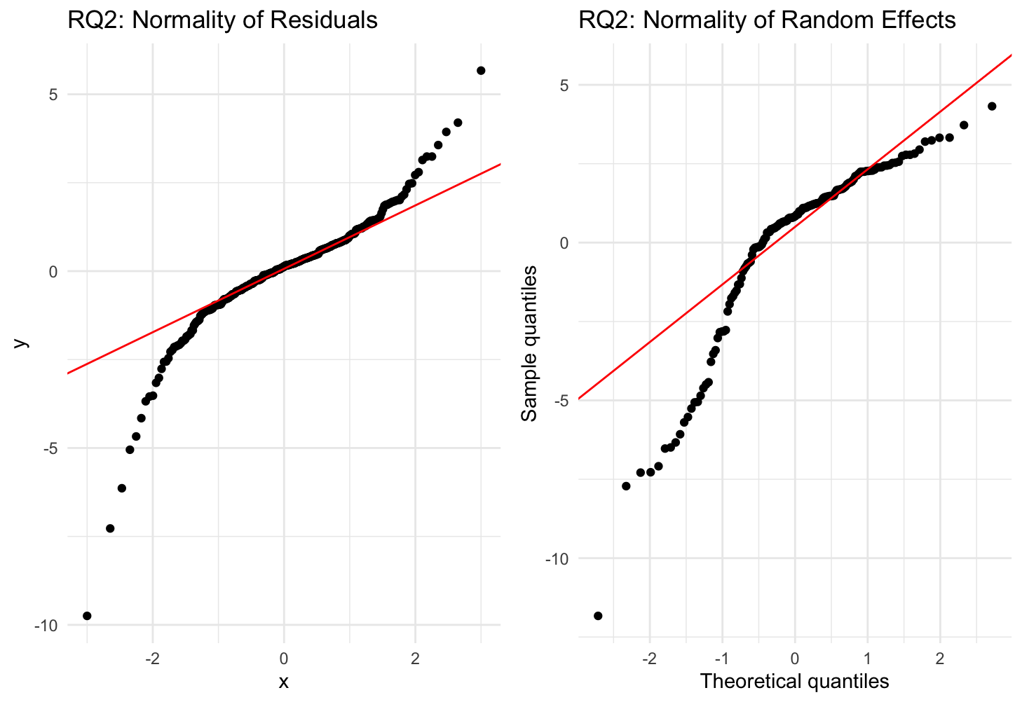
RQ2: Diagnostics

Slide 45
Summary
Key Takeaways:
RQ1: Logistic GLMM (Poor Cognition)
RQ2: Linear Mixed Model (MMSE Score)
No significant effects for Education or Visit × Education
ORs unstable with wide CIs
Outcome driven by between-person differences
MMSE declines ~0.6 points per visit
High Education: higher baseline MMSE (+1.76)
Medium Education: slower decline
Overall
Continuous MMSE outcome reveals clear patterns in cognitive decline than the binary outcome
Mixed-effects models effectively capture within-person changes over time

Slide 46
Discussion
Speaker: Yini Lu

Slide 47
RQ1 (Binary Outcome: Poor Cognition)
GLM:
Education is the only significant protective factor
Moderate discrimination (AUC = 0.726)
Limited by strong class imbalance
GEE & GLMM:
Both models unstable due to quasi-complete separation
Very few participants transition into poor cognition → insufficient variability
Key Message:
Binary outcome modeling is not reliable for capturing longitudinal risk of impairment in this dataset.

Slide 48
RQ2 (Continuous MMSE Outcome)
GLM
Cross-sectional change (ΔMMSE) computed only between two timepoints loses longitudinal information, making GLM unsuitable for capturing cognitive decline.
GEE (Population-Average)
Clear education gradient: low < medium < high
Low education: steepest decline
High education: highest cognition at all visits
Robust across correlation structures
GLMM(Subject-Specific):
High education → higher baseline MMSE; Medium education → slower decline
Notes:
Longitudinal models (GEE, GLMM) successfully capture within-person change and show consistent education effects.

Slide 49
Conclusion
Speaker: Yini Lu

Slide 50
Model Suitability
Binary outcome:
Limited by quasi-complete separation
Only GLM provides usable results (cross-sectional only)
Continuous outcome:
GEE and GLMM outperform GLM
Provide stable and interpretable trajectories

Slide 51
End slide

